Slide 1


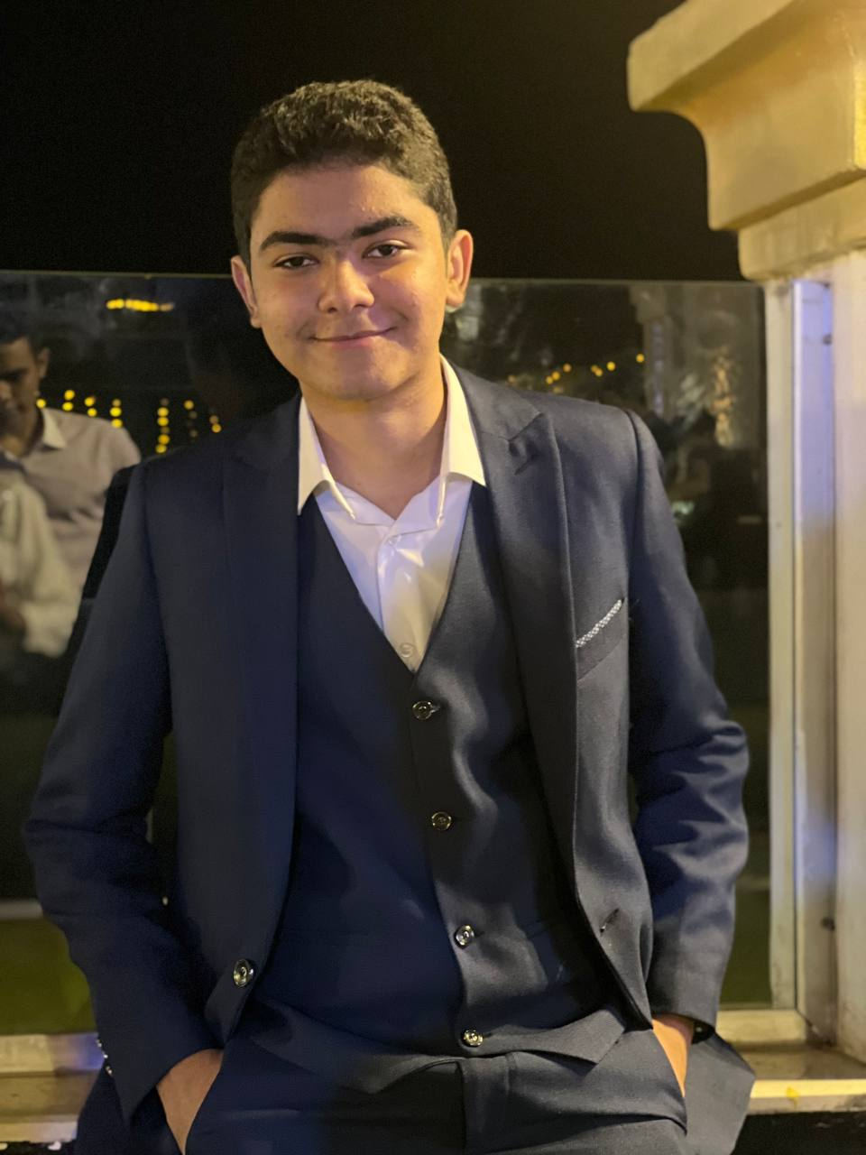
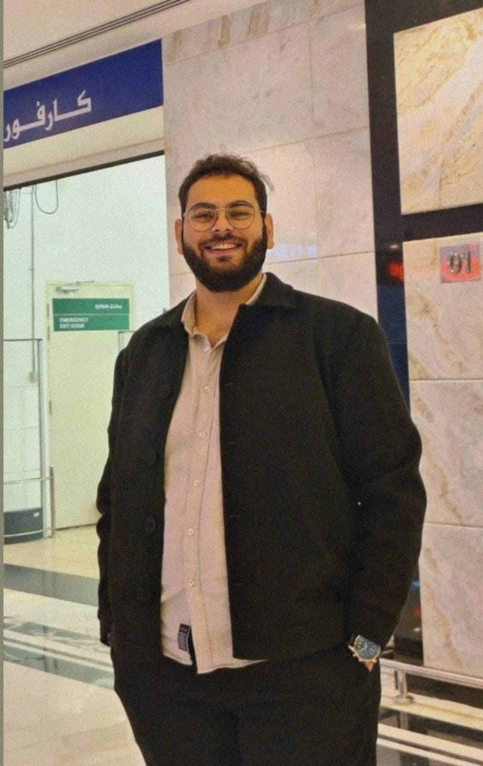
Zeyad
A highly motivated and results-oriented team leader with a proven ability to guide teams towards achieving ambitious goals. He possesses excellent communication and interpersonal skills, fostering a collaborative and positive work environment where team members feel empowered to contribute their best work.
Abdelrahman Ahmed
Jovaney Atef
21-00235
21-00826
Zeyad Mohamed
Team Leader
21-01777

Slide 2

Abdelrahman
a valuable team member who brings a positive attitude, strong work ethic, and a willingness to learn to any project. He excels at collaborating with colleagues and contributing effectively to achieving team goals.
Jovaney Atef
Shahd khaled
Malaysia
21-00826
21-01600
About country here
Team member
Abdelrahman Ahmed
21-01777
21-00235

Slide 3

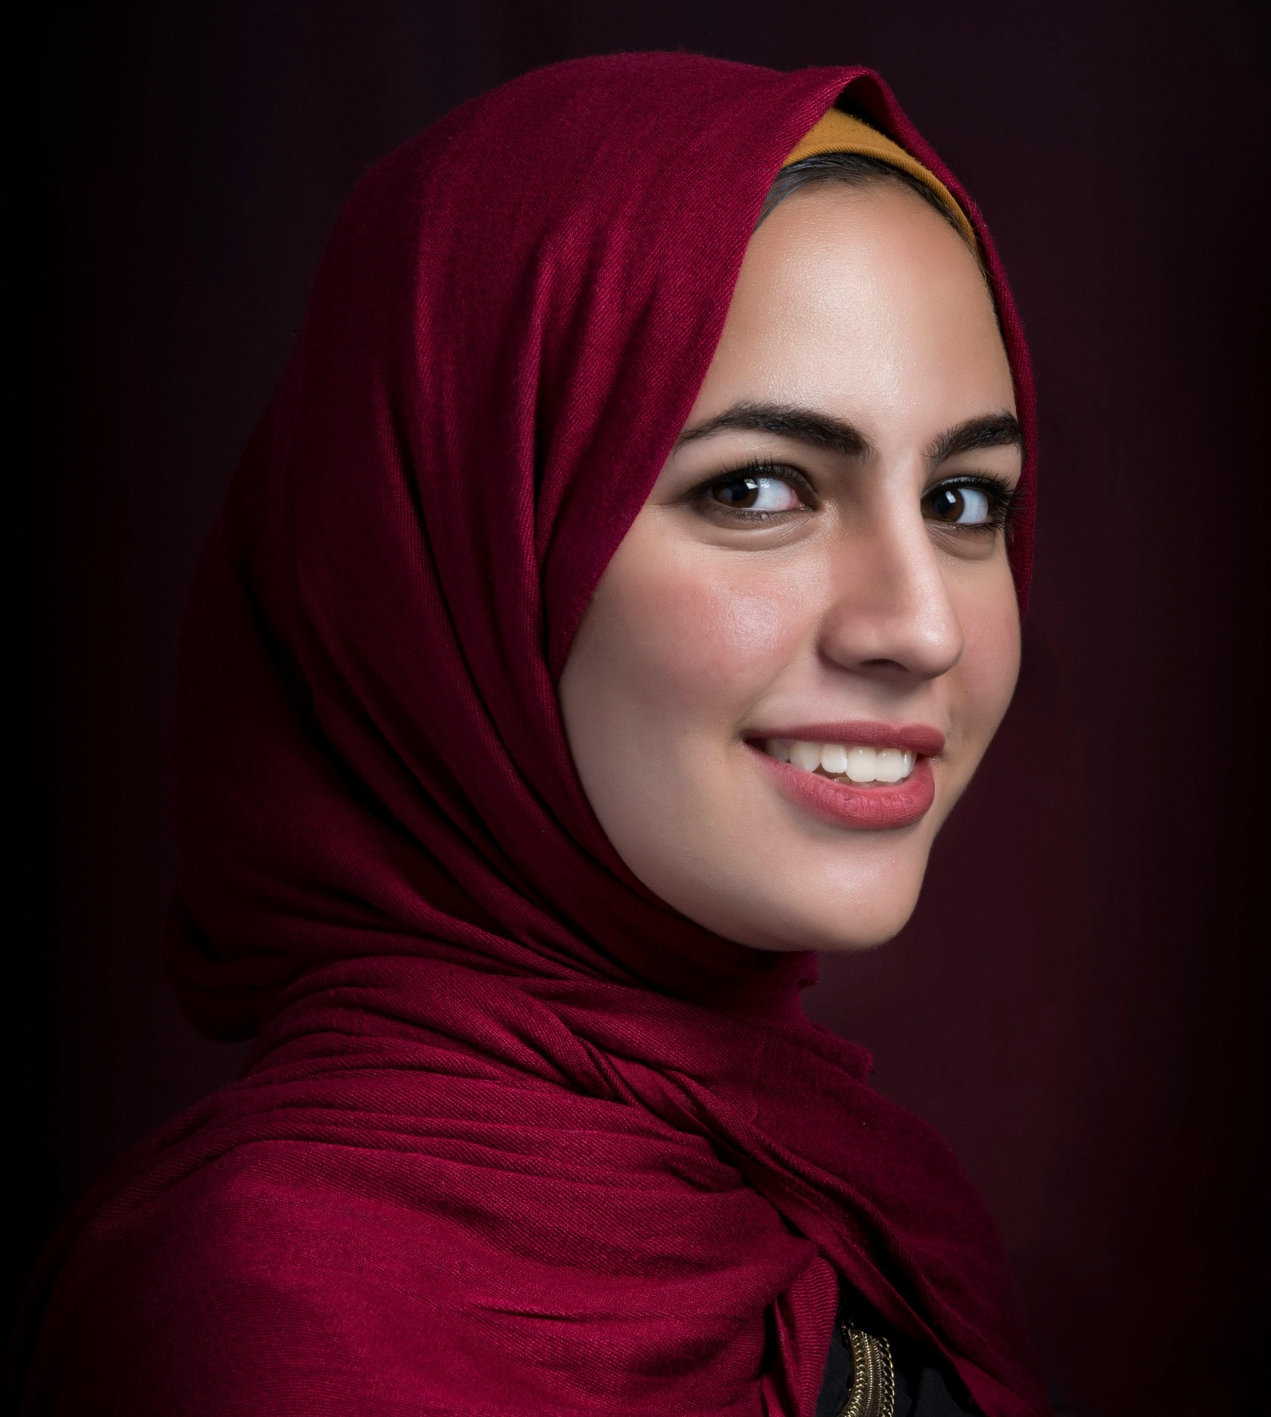
Jovaney
is a creative thinker with a passion for problem-solving .
Their innovative approach to problem-solving and ability to think outside the box consistently yield fresh
perspectives and groundbreaking solutions. adaptability and enthusiasm inject energy into the team, fostering a culture of creativity and exploration.
Shahd khaled
Rehab Mahmoud
Dubai
Team member
21-01600
21-01494
About country here
Jovaney Atef
21-00826

Slide 4

Shahd
Shahd is a proactive and resourceful team member, renowned for her exceptional organizational skills and ability to manage multiple tasks seamlessly. With a keen eye for detail and a commitment to excellence, Shahd ensures that project milestones are met efficiently and on schedule. Her proactive approach to challenges and her adeptness at streamlining processes significantly contribute to the team's success.
Rehab Mahmoud
Dina Hana
i
Canada
21-01494
21-00600
About country here
Shahd khaled
Team member
21-01600

Slide 5



Rehab
brings a wealth of expertise in coding, coupled with a strong focus on collaboration and communication. Known for her excellent interpersonal skills and ability to build consensus among team members, Rehab plays a pivotal role in fostering a cohesive and harmonious work environment. Her dedication to fostering strong team dynamics and facilitating open communication enhances the overall effectiveness of the team.
Dina Hana
Amira Mohamed
Ca
Japan
21-00600
About country here
21-00480
Rehab Mahmoud
Team member
21-01494

Slide 6
Dina
Dina is a meticulous and detail-oriented professional, known for her analytical prowess and strategic thinking. she excels in problem-solving and critical analysis. Dina's dedication to precision and her ability to navigate complex challenges make her an invaluable asset to the team.
Amira Mohamed
Ca
Japan
About country here
Team member
Dina Hana
21-00480
21-00600

Slide 7

Amira
known for her kindness and eagerness to lend a helping hand. With a keen eye for design and a knack for selecting colors, she brings a unique flair to our projects. Her collaborative spirit and dedication make her an invaluable asset to our team,
Ca
Japan
About country here
Amira Mohamed
21-00480
Team member

Slide 8

Introduction to Pattern Recognition
Pattern recognition is a powerful field of artificial intelligence that enables machines to identify and classify patterns within data. This discipline combines techniques from machine learning, statistics, and signal processing to build models that can recognize complex structures and make intelligent decisions.

Slide 9

Logistic Regression Algorithms
Logistic regression is a powerful machine learning algorithm used for binary classification tasks. It models the probability of a binary outcome using a logistic function. This algorithm is highly versatile, efficient, and provides interpretable results, making it a popular choice for many pattern recognition applications.
Estimates the probability of a binary outcome based on one or more predictor variables
Uses a logistic function to map the linear regression output to a probability between 0 and 1
Optimizes model parameters using techniques like maximum likelihood estimation
Accuracy:65.2%

Slide 10

Random Forest Algorithms
Random Forest is an ensemble learning algorithm that combines multiple decision trees to improve the accuracy and robustness of pattern recognition models. By aggregating the predictions of many individual trees, Random Forest can handle complex, nonlinear relationships in data and mitigate the risk of overfitting.
Constructs a forest of decision trees using random subsets of features
Ensembles the predictions of the individual trees to make a final classification or regression
Enables effective handling of high-dimensional, noisy data with correlated features
Accuracy: 77.8%

Slide 11
Decision Tree Algorithms
Decision trees are versatile pattern recognition models that recursively partition the input space to make predictions. By learning a hierarchy of if-then-else rules, decision trees can effectively capture complex, nonlinear relationships in data.
Build a tree-like model of decisions and their possible consequences
Recursively split the data based on the feature that provides the greatest information gain
Handle both categorical and numerical data, making them highly flexible
Accuracy:60.3%

Slide 12
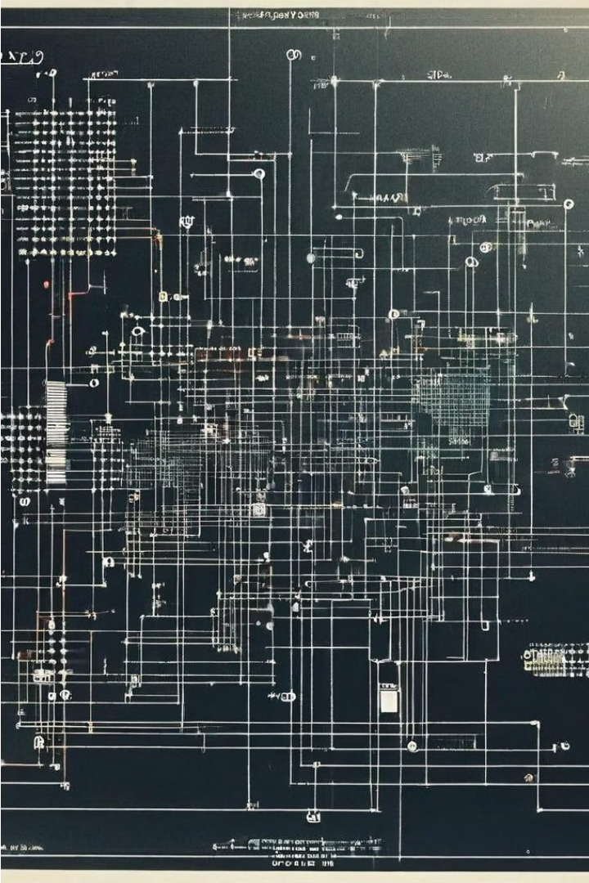
SVM Algorithms
Support Vector Machines (SVMs) are powerful supervised learning algorithms used for both classification and regression tasks in pattern recognition. SVMs find the optimal hyperplane that maximizes the margin between classes, resulting in highly accurate and robust models.
Constructs a hyperplane to separate classes with maximum margin
Handles complex, nonlinear relationships by mapping data to higher-dimensional spaces
Provides excellent performance on high-dimensional datasets with relatively few training samples
Accuracy: 67.8%

Slide 13

Naive Bayes Algorithms
Naive Bayes is a simple yet powerful probabilistic machine learning algorithm used for pattern recognition tasks. It relies on the strong independence assumption to efficiently model complex relationships in data, making it a popular choice for classification problems.
Applies Bayes' theorem to calculate the probability of a class given the observed features
Assumes independence between features, which simplifies the computations
Excels at handling high-dimensional datasets and categorical variables
Accuracy : 61.3%

Slide 14

Challenges in Pattern Recognition
We faced a lot of problems during the project like having a lot of outliers and errors with the implementation of several functions.
And in the tight schedule we were given w managed to implement 6 different models and run them without any errors.

Slide 15
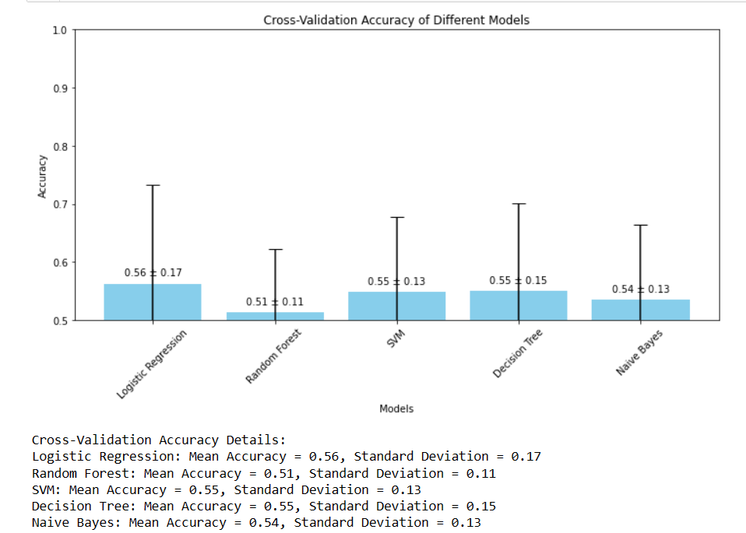
Cross-Validation

Slide 16
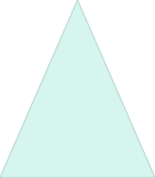


Future Trends and Advancements
AI-Powered Pattern Recognition
1
Leveraging deep learning and neural networks for highly accurate, automated pattern detection
Multimodal Fusion
2
Integrating diverse data sources, including images, text, and sensor data, for robust pattern recognition
Explainable AI
3
Developing pattern recognition models with transparency and interpretability for increased trust and adoption

Slide 17
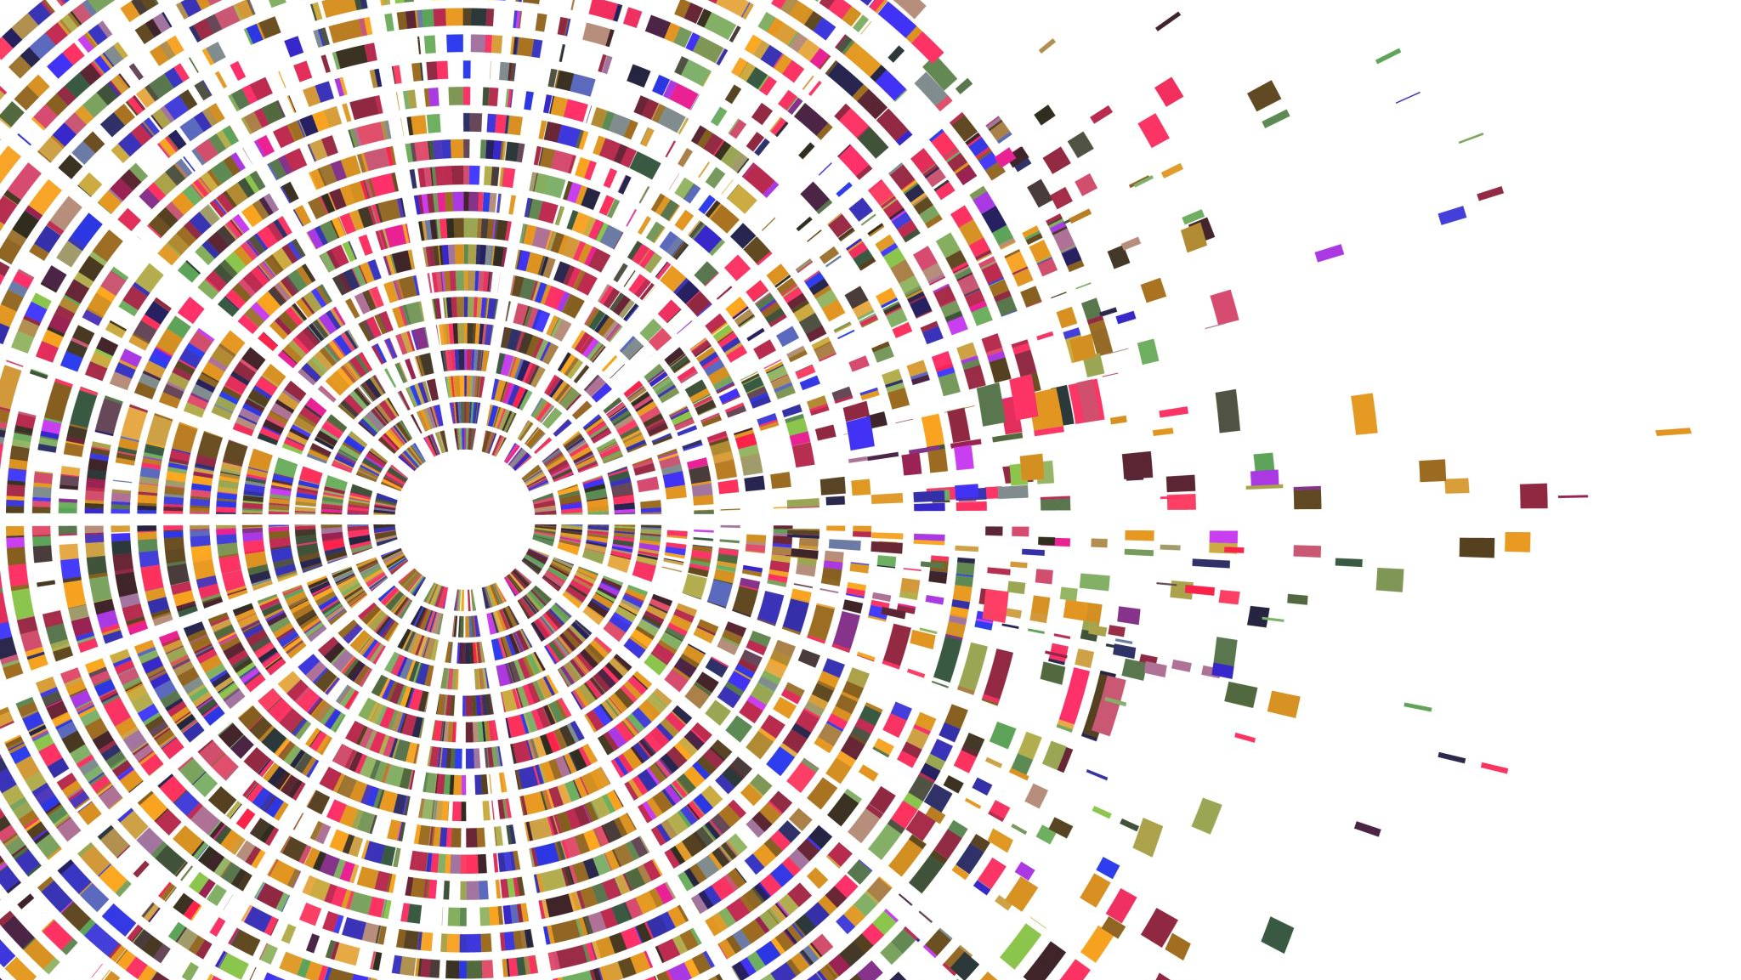
Thank you

